Slide 1
Common Value Auctions

Slide 2
Coin auction
What’s for sale: the coins in this jar.
We’ll run an ascending auction

Slide 3
Coin auction
What’s for sale: the coins in this jar.
Ascending auction
What if one person gets to count the coins.
Does this change your bid? Why?

Slide 4
The winner’s curse
Winning the jar means that everyone else in the class was more pessimistic about its contents.
Winning is “bad news”
  If you had an initial estimate of $10, seeing everyone else drop out first (especially the person with good information!) should cause you to revise your estimate downward.
Equilibrium bidding should account for this.

Slide 5
Common Value Auctions
Today we will look at “common value” auction settings, where bidders have differential information about the value of the item being sold.
Three main issues
  Strategic bidding and the winner’s curse
  Information aggregation and “price discovery”
  Selling strategies and information disclosure

Slide 6
Imperfect Estimate Model
Two bidders with common value v.
v is drawn at random from a known distribution.
Bidder 1 receives a “signal” s₁ (correlated with v)
Bidder 2 receives a signal s₂
Signals provide information about v, but not perfect.
Assume: E[v| s₁, s₂] is increasing in s₁, s₂.
Second price sealed bid, or ascending auction
How should bidders account for the winner’s curse?

Slide 7
How to Bid?
Suppose bidder 2 uses a strategy: bid b(s₂).
Bidder 1 has a signal s₁. How to bid?
Consider bidding p, or slightly higher or lower.
Makes no difference if b(s₂) < p-ε.
Makes no difference if b(s₂) > p+ε.
Only matters if b(s₂) ≈ p.
The only way p could be an optimal bid for bidder 1 is that she’s just indifferent to winning or losing if it turns out that b(s₂)=p. Then she’ll have no reason to want to bid higher or lower.
If b(s₂)=p, then if bidder 1 wins, she pays p, and her expected value for the object is E[v|s₁,s₂=b⁻¹(p)]. Indifference means E[v|s₁,s₂=b⁻¹(p)]=p.

Slide 8
Symmetric Equilibrium
Therefore, bidder 1’s best response given signal s₁ is to bid
p(s₁) = E[v|s₁,s₂=b⁻¹(p(s₁)]
Let’s look for a symmetric equilibrium where bidder 1’s strategy p(s₁) and 2’s strategy b(s₂) are the same function, i.e. p(x)=b(x) for any x.
This means bidder 1’s equilibrium strategy is
p(s₁) = E[v|s₁,s₂=s₁]
To find her equilibrium bid, bidder 1 should imagine that bidder 2 has the exact same signal, and bid her value in that event.

Slide 9
The No Regret Property
Suppose both bidders use the equilibrium strategy: p(s) = E[v|s,s]
Suppose bidder 1 wins ⇔ p(s₁) > p(s₂) ⇔ s₁ > s₂
Bidder 1’s expected value post-auction: E[v|s₁,s₂]
Bidder 1’s payment: p(s₂) = E[v|s₂,s₂] (smaller)
Bidder 1 is glad she won, and doesn’t want to change her bid.
Bidder 2’s expected value post-auction: E[v|s₁,s₂]
If bid higher and won, would pay: p(s₁) = E[v|s₁,s₁] (bigger)
Bidder 2 is glad she lost, and doesn’t want to change her bid.

Slide 10
Common Value Bidding
Key idea in common value auctions
Bidders must account that winning or
losing conveys information about
the information of other bidders.
This information can be either positive or negative.

Slide 11
Winner’s or Loser’s Curse?
How does accounting for the information of others affect your estimate of the item value?
Case 1: 10 bidders, 1 item.
  Winning means other signals were all lower.
Case 2: 10 bidders, 9 items.
  Losing means other signals were all higher.

Slide 12
Not just uncertainty
The logic of common values comes from the fact that other bidders may have information that is relevant for your value, not just from the value being uncertain.
Suppose we’re bidding for the jar of coins…
  I know there are exactly 650 pennies.
  But I think there’s a fifty percent chance I’ll lose the jar.
  My value of winning is less than 650 ($3.25 if risk-neutral).
  But I don’t care about the other bidders’ estimates (except insofar as bidders with high estimates drive up the auction price).

Slide 13
Providing Information to Bidders
Deciding how much information to provide to bidders – e.g. what information to disclose if you are selling a house, or a company – can be a tricky issue.
  Milgrom-Weber “linkage principle” – under certain conditions seller should provide information to alleviate the winner’s curse and connect the price more closely to the true value.
  In other cases, giving bidders the opportunity to become informed can create informational asymmetries – seller does better to keep bidders in the dark.

Slide 14

De Beers Diamond Example
De Beers sells a large fraction of the world’s uncut diamonds: at one point, 85%.
It sells these diamonds at regularly scheduled “sights”.
Each buyer is given a box of diamonds and a price. He or she must decide whether to buy the whole box at that price.
What is the rationale for having so little inspection and pricing of individual items?
De Beers “sight” boxes

Slide 15
Financial Securities Example
It can be easier to trade financial securities if there is less potential for asymmetric information.
  Buyer is less concerned about the winner’s curse (i.e. the fact that the seller was willing to sell), or vice-versa.
  The incentives to spend a lot of time collecting information to exploit other traders may be reduced (lower transaction costs).
Helps to understand attraction of certain securities
  Index funds (hard to know where overall market is going, even if insiders might have good information about individual stocks.)
  Bonds backed by pools of mortgages (hard to know if many loans will default, although sometimes like in 2007 it can happen!).

Slide 16
Information aggregation
How many miles is it to drive from New York to Chicago?
Answer

Slide 17
Information aggregation
Suppose we have many bidders, and each has an independent estimate s_{i} = v+e_{i.}
Median of the bidder’s estimates s_{i} is likely to be a very good estimate of v. Why?
  Median(s_{i}) = Median(v+e_{i}) = v+Median(e_{i}) ≈ v.
“The wisdom of crowds”; Galton example.

Slide 18
Information aggregation
Suppose we have many bidders, and each has an independent estimate s_{i} = v+e_{i.}
If many bidders compete in an auction, is the resulting price a good estimate of v?
  Potentially YES!, auction price can aggregate information.
  First shown by Stanford profs. Wilson, Milgrom.
  Let’s go through a somewhat loose sketch of the argument.

Slide 19
Why Information Aggregation?
Assume N bidders, K=N/2 items, top K bids win and pay K+1st bid.
Equilibrium bidding: bid so that if you “just” win, you’ll “just” want to win (else should raise/lower bid).
b(s_{i}) = E[v | s_{i} is tied for K+1st highest of N]
≈ E[v | s_{i} is median signal] (assume N large)
  = E[v | v+median(e)= s_{i}]
  = s_{i}
Price will be b(s_{K+1})=s_{K+1}, where s_{K+1} is K+1st highest signal.
So the auction price will be approximately the median signal!

Slide 20
Information Aggregation
If value if v, signals will be distributed around v – and if there are enough bidders, the true value will be close to the median signal.
vL
vH

Slide 21
Common values in practice
Many auctions have some “common value” aspect
  Treasury bill auctions – everyone may have a guess about the trading price after the auction, but no one knows for sure. Same for IPOs and new debt issuance.
  Timber auctions: what kind of timber is actually out there on the tract that’s being sold.
  Oil lease auctions: oil is under the Gulf of Mexico, bidders do independent seismic studies – each has valuable information.

Slide 22
OCS Auctions
The US government auctions the right to drill for oil on the outer continental shelf.
Value of oil is similar to the different bidders, but no one knows how much oil there is, or if there’s none.
Prior to the auction, the bidders do seismic studies.
Two kinds of sale
  “Wildcat sale” - new territory being sold
  “Drainage sale” - territory adjacent to existing tract.
These are like the “wallet auctions” we ran in class!

Slide 23
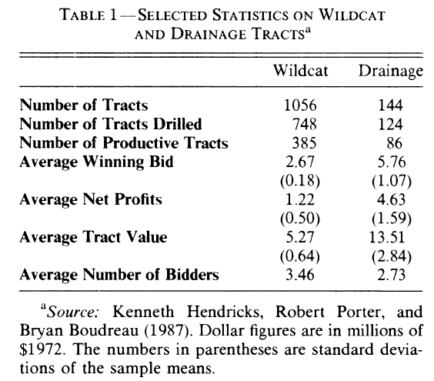
Wildcat vs Drainage

Slide 24
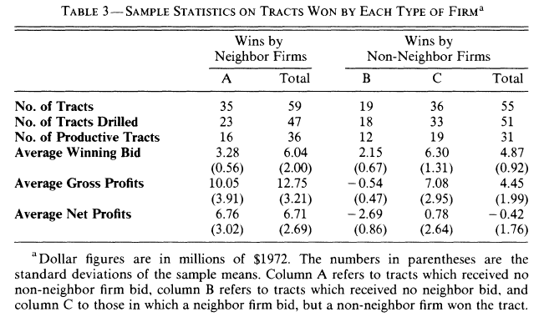
Drainage sales

Slide 25
Explaining the Results
Comparing wildcat and drainage sales
  Wildcat sales yield low profits => competition.
  Drainage sales are profitable, but only for “insiders” => insiders have an advantage.

Slide 26
Internet Advertising
Internet advertisers often can identify people or profile their behavior and then bid to show them ads.
Concern in some advertising auctions
  Sophisticated advertisers potentially can “cherry-pick” the best opportunities by bidding high only for those impressions.
  Less sophisticated advertisers who submit the same bid for good and bad opportunities might be left with only the bad ones.
Example: the Yahoo! - “Happy Meal” contract.

Slide 27

Initial Public Offerings
In an IPO, all buyers essentially have the same value v, the stock price once trading opens.
You should want to buy in the IPO if you think the IPO price p is less than v.
Do IPOs sell at a discount? Not necessarily. If everyone know v, competition and “no arbitrage” should drive price up to v.

Slide 28
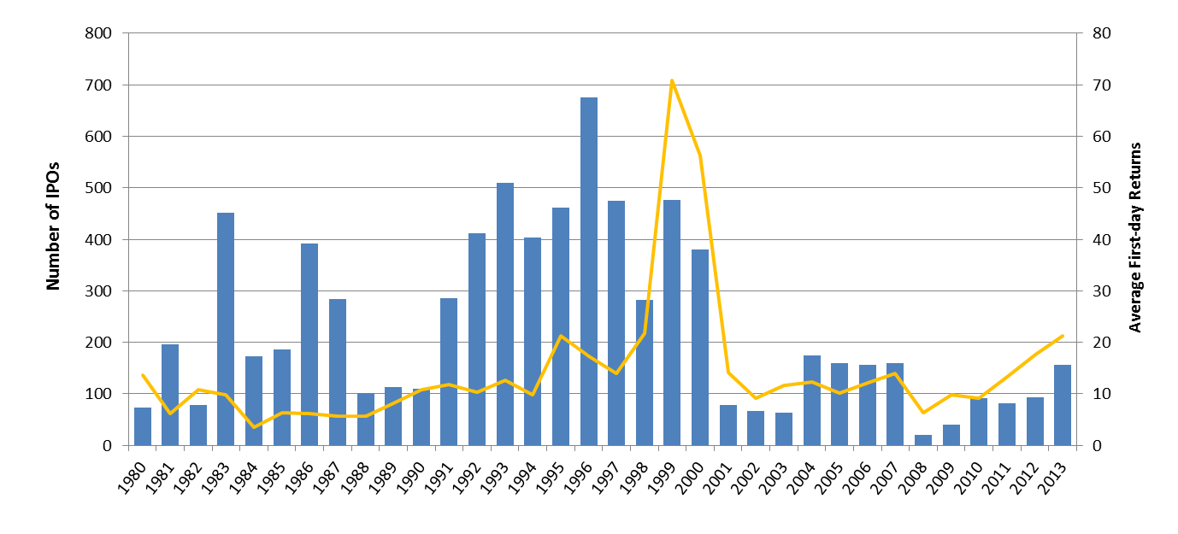
IPOs Sell at a Discount
Number of Offerings (bars) and Average First-day Returns (yellow) on US IPOs, 1980-2013
Source: Jay Ritter, University of Florida.
The number of IPOs excludes closed-end funds, REITs, SPACs, natural resource limited partnerships, ADRs, bank and S&L IPOs, IPOs with an offer price below $5 per share, unit offers, and IPOs that are not CRSP-listed within six months of the IPO.

Slide 29
IPO Underpricing
One explanation is the winner’s curse.
  If some potential buyers are informed, then if you obtain shares in the IPO, it may mean the informed buyers stayed away.
  Therefore, regular buyers may need to be cautious, and as a result, IPOs sell at a discount.
There are alternative explanations
  I-Banks set IPO prices low to cater to clients.
  I-Banks deliberately choose a low price to have control over who gets allocated shares, and avoid any risk of under-sell.
Perhaps well-designed IPO auction could aggregate information, but IPOs generally don’t use auctions…

Slide 30
Summary
Many auctions have a “common value” flavor.
In common value settings:
  The event of winning reveals information about opponent estimates, and bidders must account for this.
  Bidders without accurate information must be cautious when bidding against bidders with very good information.
  If there are many bidders and dispersed information, the auction price can be a useful indicator of the item’s value.
  The management of information is very important.

